Slide 1
CRSSIET JHAJJAR
GENERAL INFO
Campus size: 22acre
Established :2017
Address: Haryana, Jhajjar (kheto k beech)
Mode of admission: Jee mains
Affiliated to maharishi dayanand university
58km away from indira gandhi international airport

Slide 2
Chatysus

Slide 3
Scholarship Schemes
1) scholarship scheme for sc students(2.5 lakh)
2) scholarship scheme for BC students(1.5lakh)
3) B.R. Ambedkar merit scholarship scheme
4) Scholarship scheme for UP residents
5) Scholarship scheme for bihar residents
6) Scholarship scheme for miniority students of the states

Slide 4
Fee Sturcture
1st year fee : 40,000
2nd year fees: 40,000
3rd year fees: 40,000
4th year fees: 40,000
At the time of admission 25000 to be paid and balance in next semester
Hostel fee per year: 10100
Total: 2,00,400

Slide 5
Courses
Electronics and Communication Engineering
Electrical Engineering
Civil engineering
Computer science engineering
Mechanical engineering

Slide 6
facilities
Library
Workshop
Scholarship
Hostel
Sports
fests

Slide 7
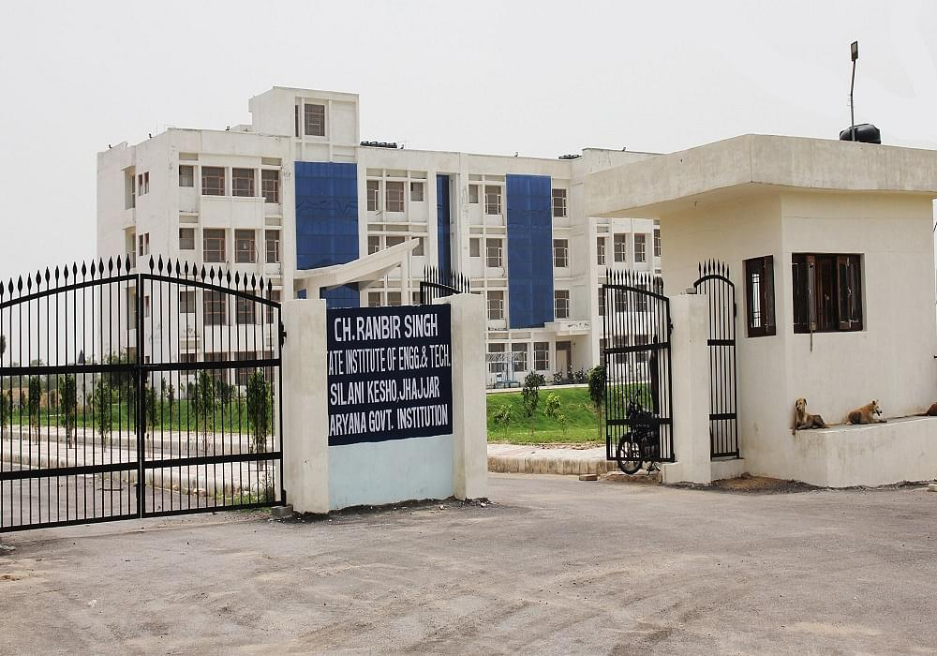
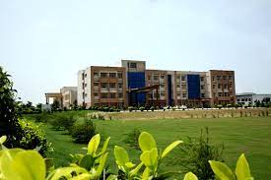

Slide 8
PLACEMENTS
In CSE Branch
Highest Package-9LPA
Lowest Package-1LPA
Average Package-4LPA
In Electrical Engineering
Highest Package-4LPA
Lowest Package-2.5LPA
Average Package-3LPA

